Slide 1
Western Countries Financial Data Capstone Project
Exploration • Cleaning • SQL
• Power BI Dashboard

Slide 2
Project Summary
Sheet used: Sheet1
Rows (raw): 700
Columns: 16
Columns list: Segment, Country, Product, Discount Band, Units Sold, Manufacturing Price, Sale Price, Gross Sales, Discounts, Sales, COGS, Profit, Date, Month Number, Month Name, Year
Detected columns: date=Date, country=Country, product=Product, segment=Segment, sales=Gross Sales, profit=Profit, units=Units Sold, discount=Discount Band
Missing values (any): 700
Duplicates (exact rows): 0

Slide 3
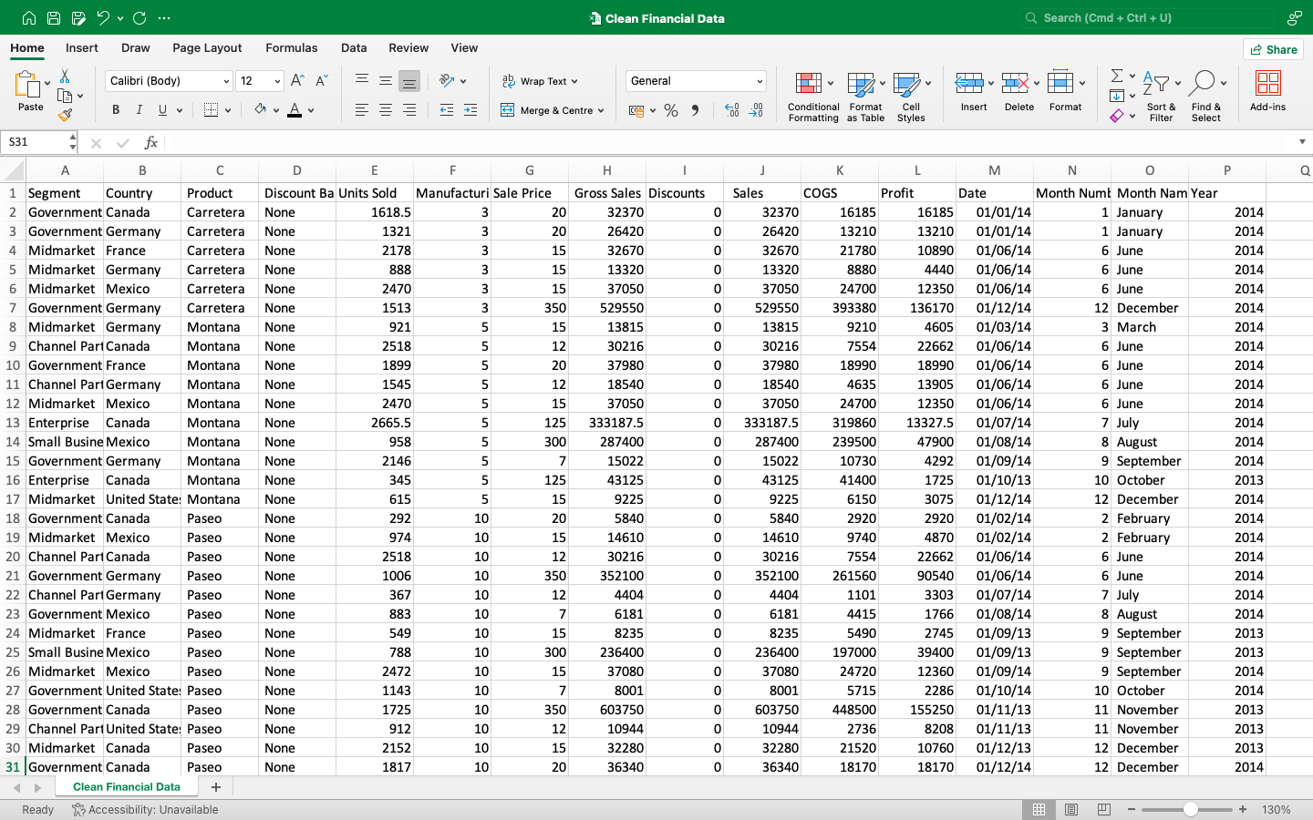
Clean Financial Data

Slide 4
Sales by Country
Graphical Analysis

Slide 5
Segment wise Sales

Slide 6
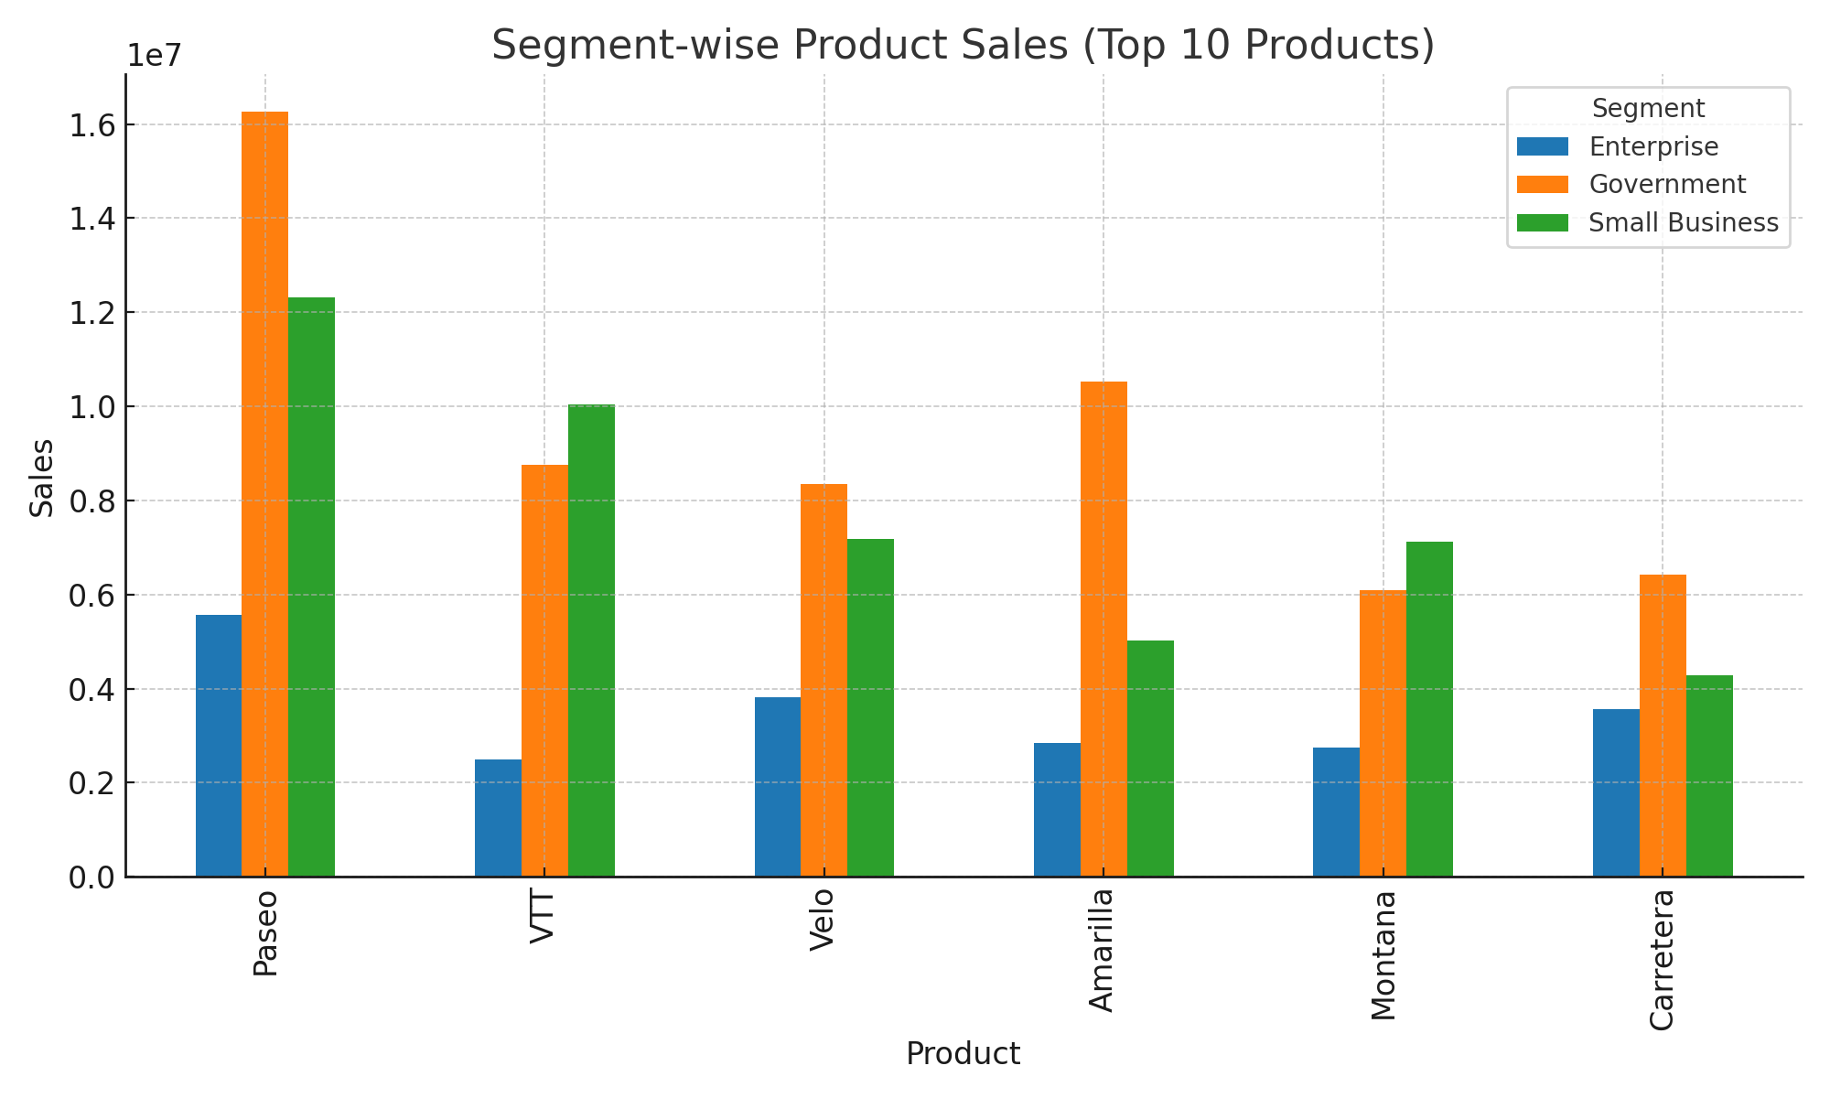
Segment wise Product Sales Top 10

Slide 7
Unit Sold Yearly

Slide 8
Segment wise Profit

Slide 9
Profit By Quarter

Slide 10
Sales and Profit by Quarter

Slide 11
Yearly Sales and Profit

Slide 12
Sales vs Profit

Slide 13
Derive Insights from Graphical Analysis
The Enterprise segment has the highest sales and strong profitability, while Government delivers high margins despite the lowest sales.
The United States Of America records the highest sales but has a lower profit margin, suggesting high operational costs or discounts.
France achieves the best profitability despite lower sales, showing efficient cost management.
Mexico and Germany also perform well, with healthy profit margins.
Paseo is the top-selling and most profitable product, contributing significantly to overall gains.
Montana has a small profit, while Amarilla, Carretera, Velo, and VTT suffer losses.
The gap between high sales and low profit in some areas suggests the need for margin improvement strategies.
Overall, focusing on profitable segments, countries, and products while reducing losses in underperforming areas can boost profitability.

Slide 14
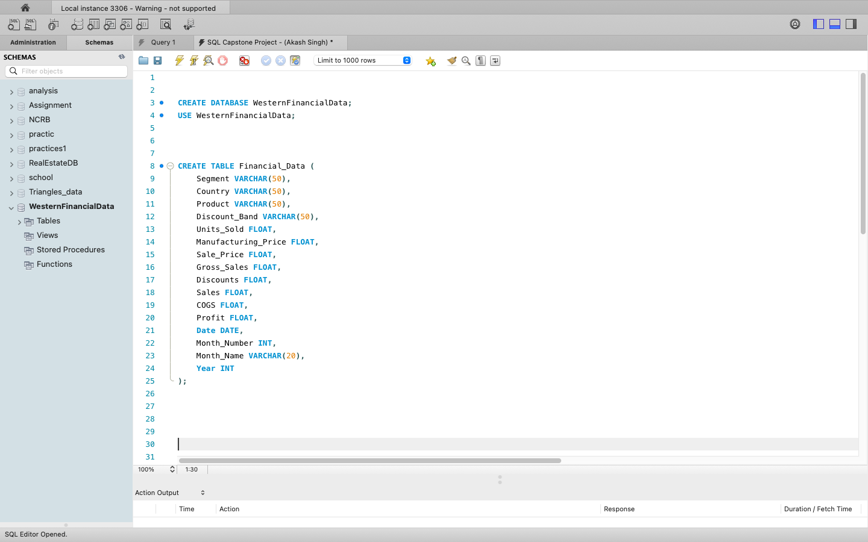
Insert the data in MySQL Sever by making a Database and defining the Database Table.

Slide 15
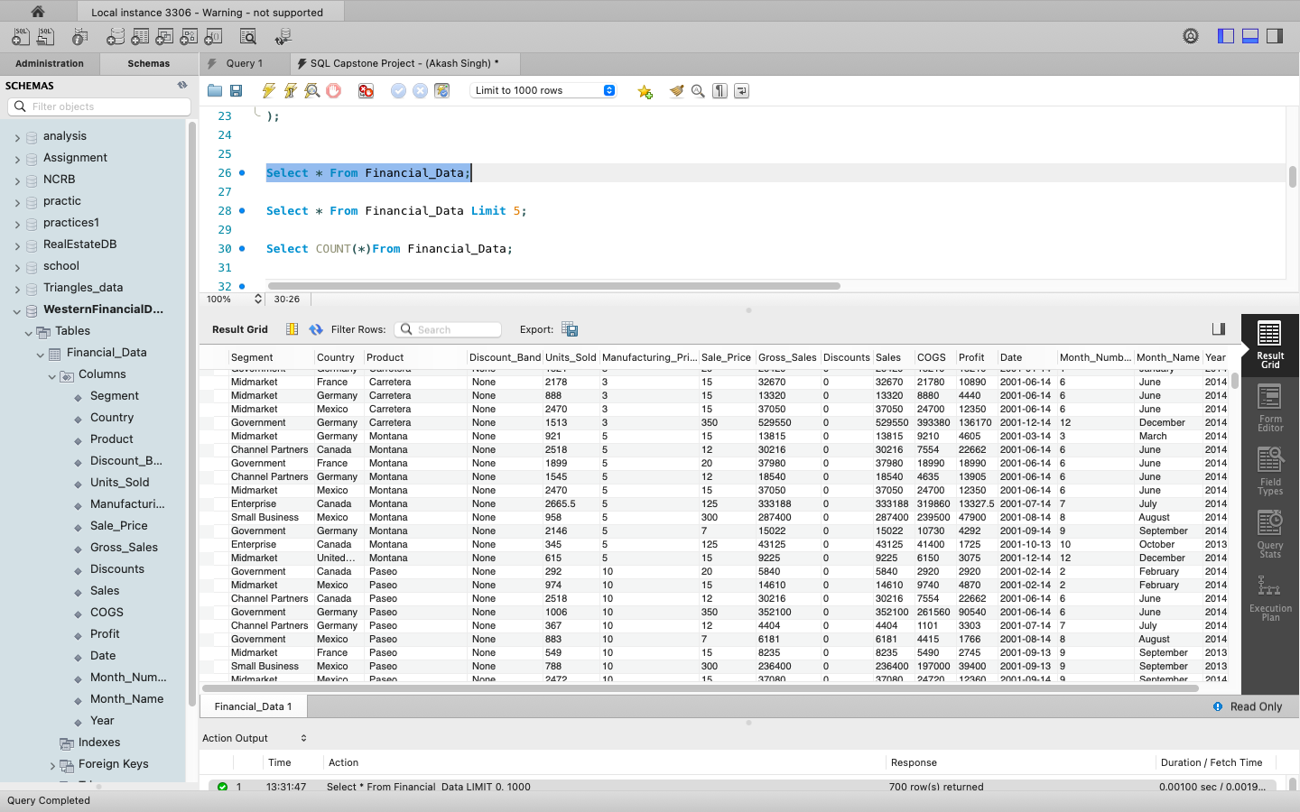
Verify the data is properly imported in the MySQL Database or Not. (Try to running few queries)

Slide 16
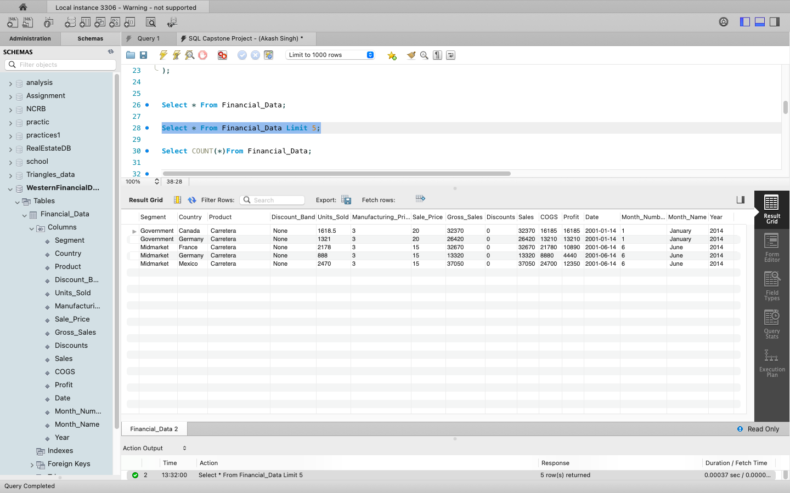

Slide 17
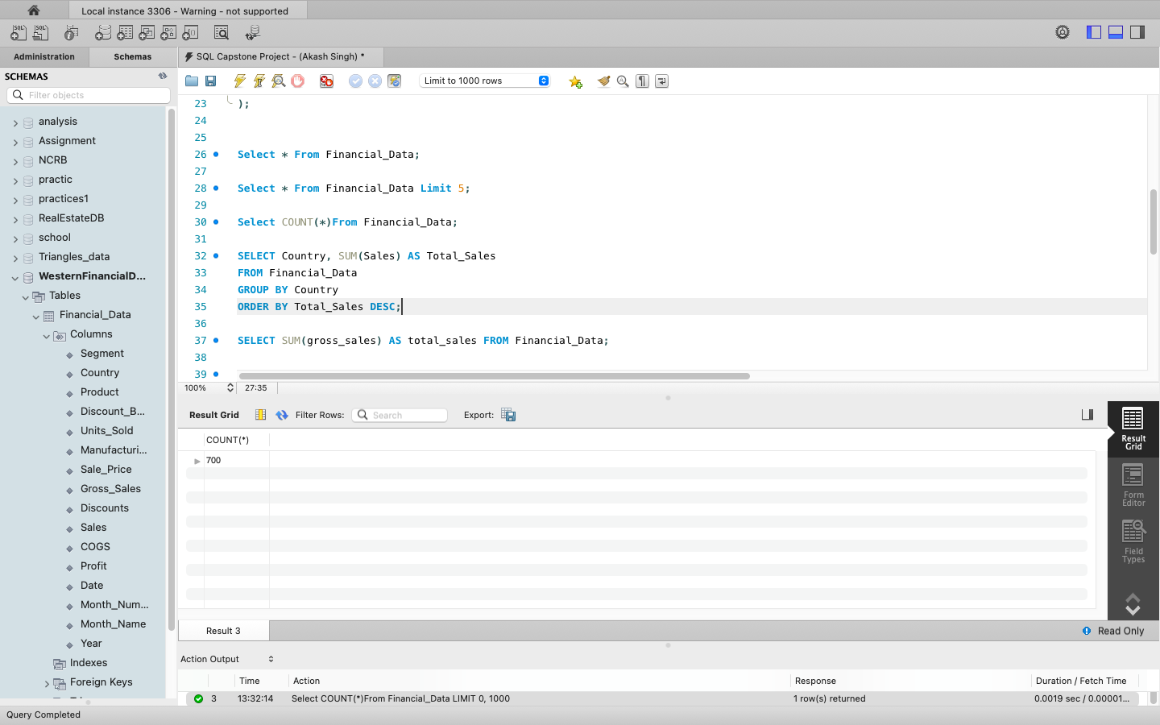

Slide 18
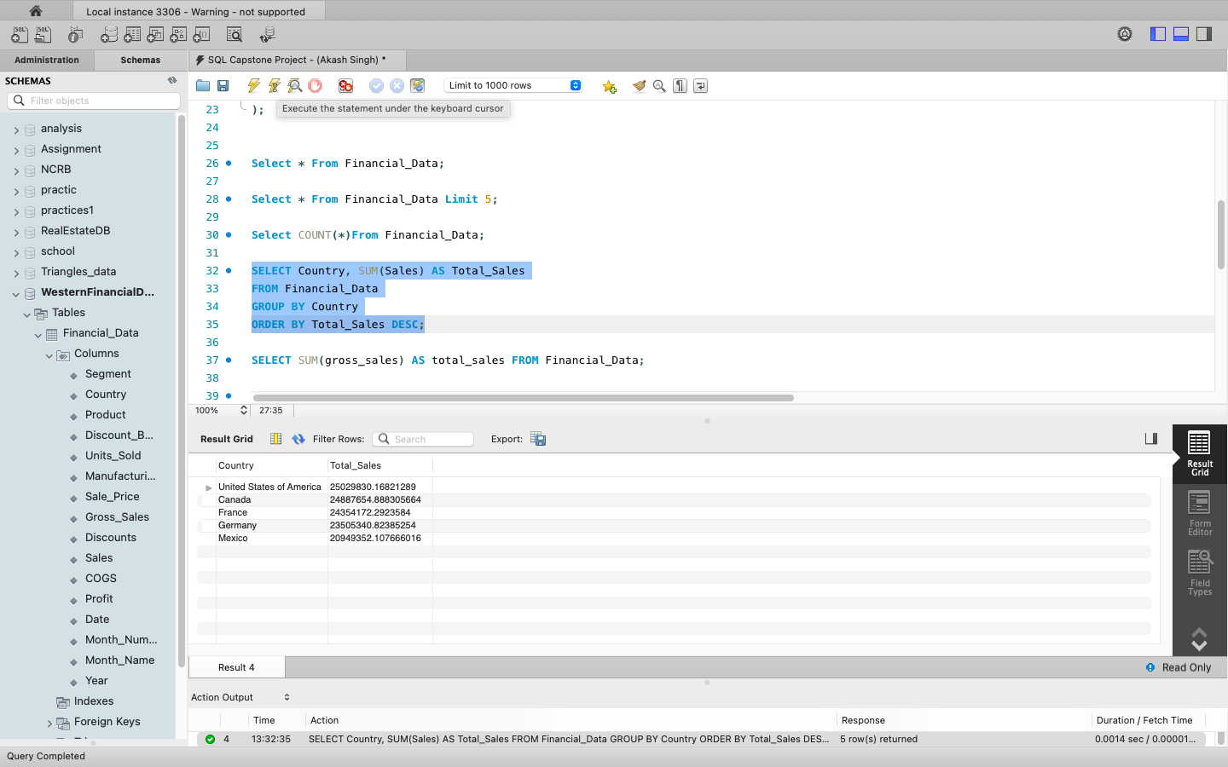

Slide 19
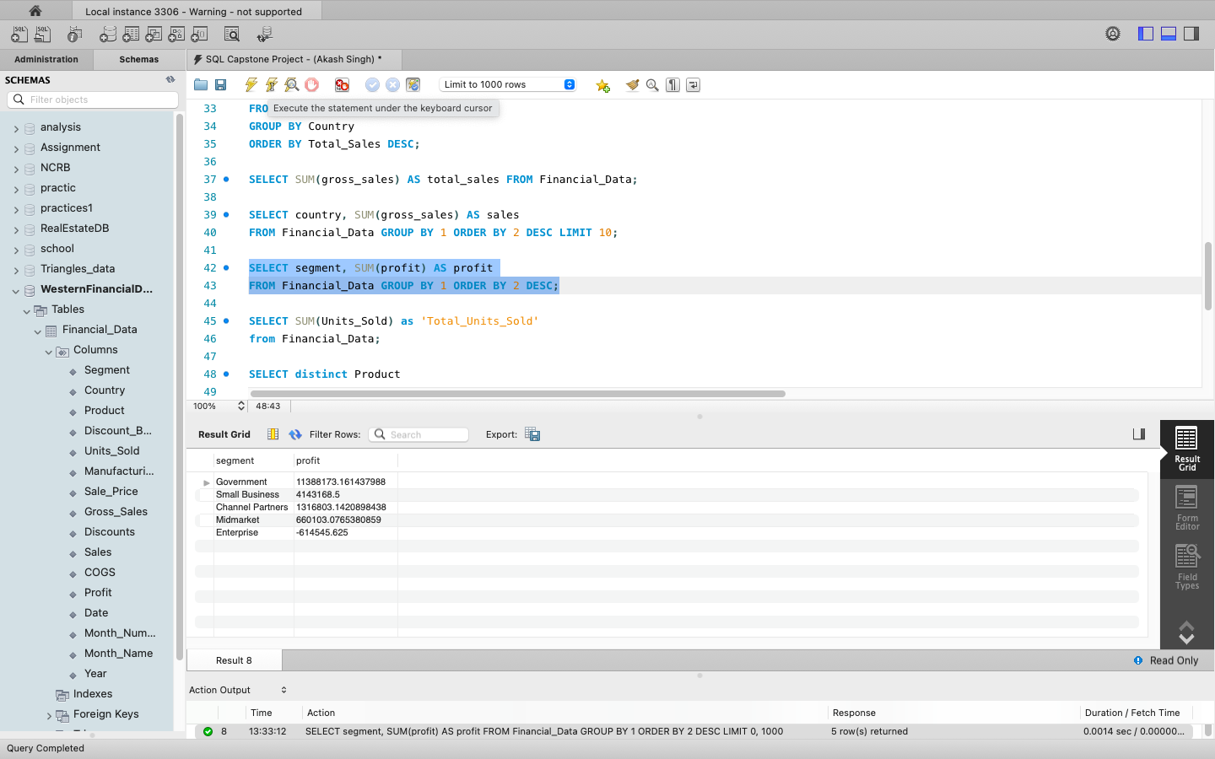

Slide 20
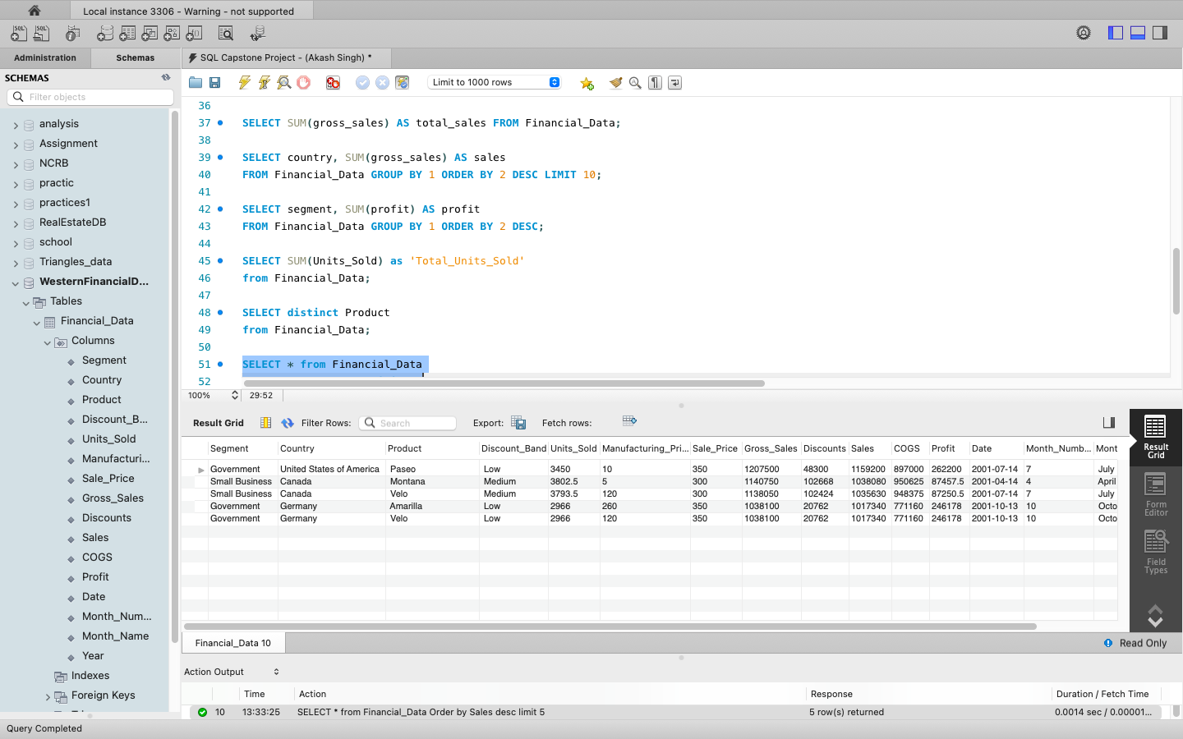

Slide 21
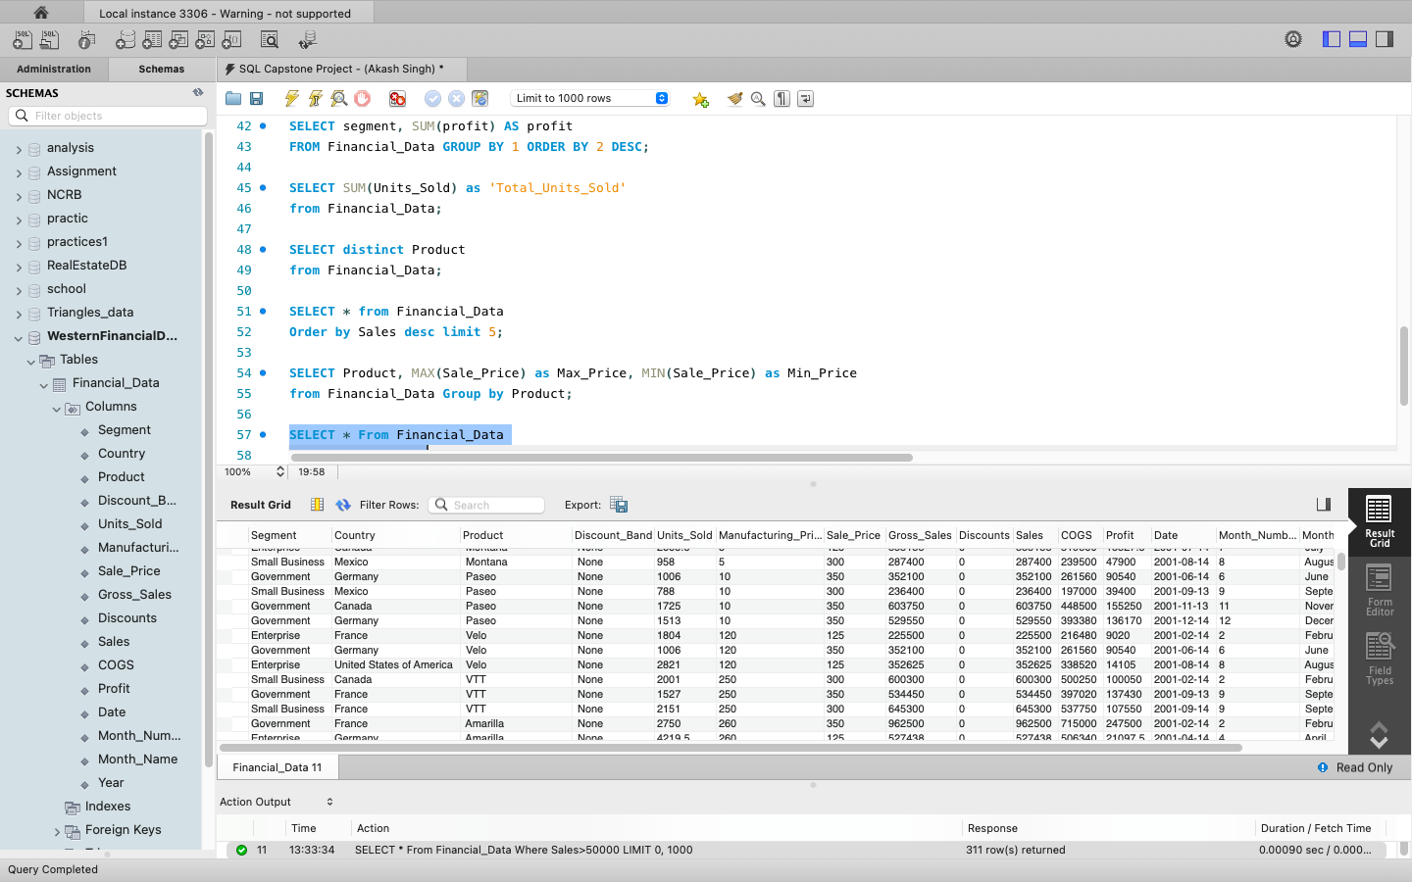

Slide 22
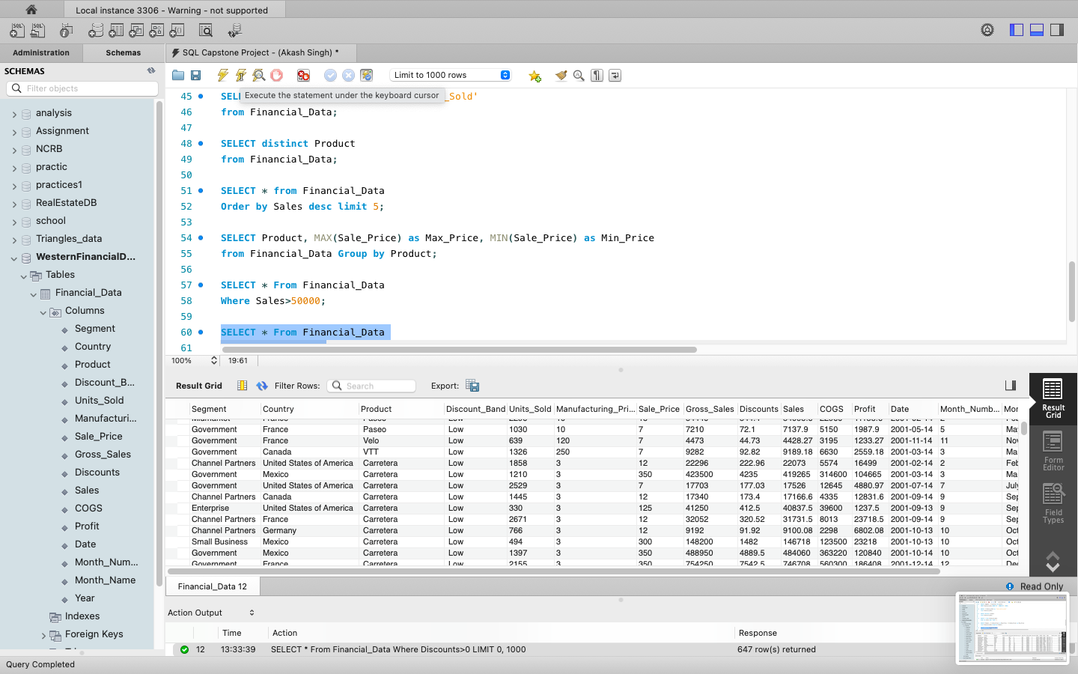

Slide 23
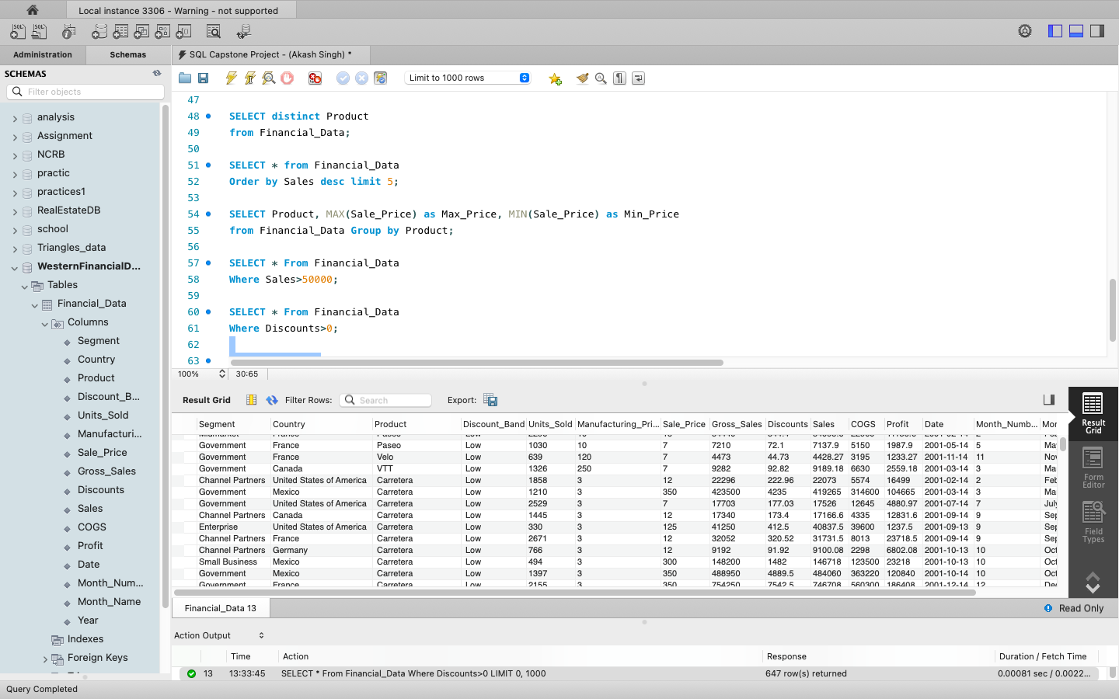

Slide 24
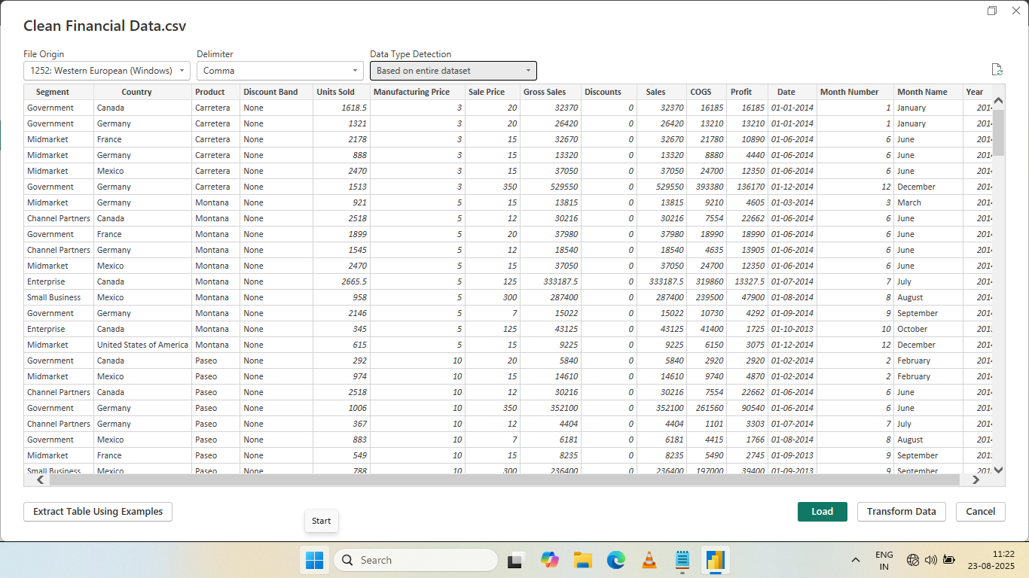
Import the data from MySQL Database into Power BI. Then verify the data is properly imported or not.

Slide 25
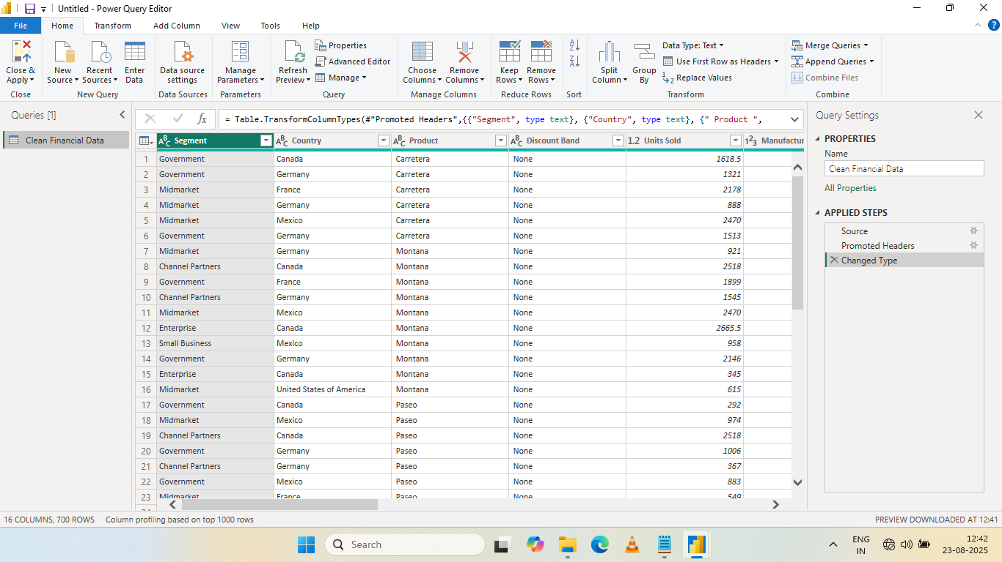
Perform data cleaning and other possible operations on data using Power Query editor.

Slide 26
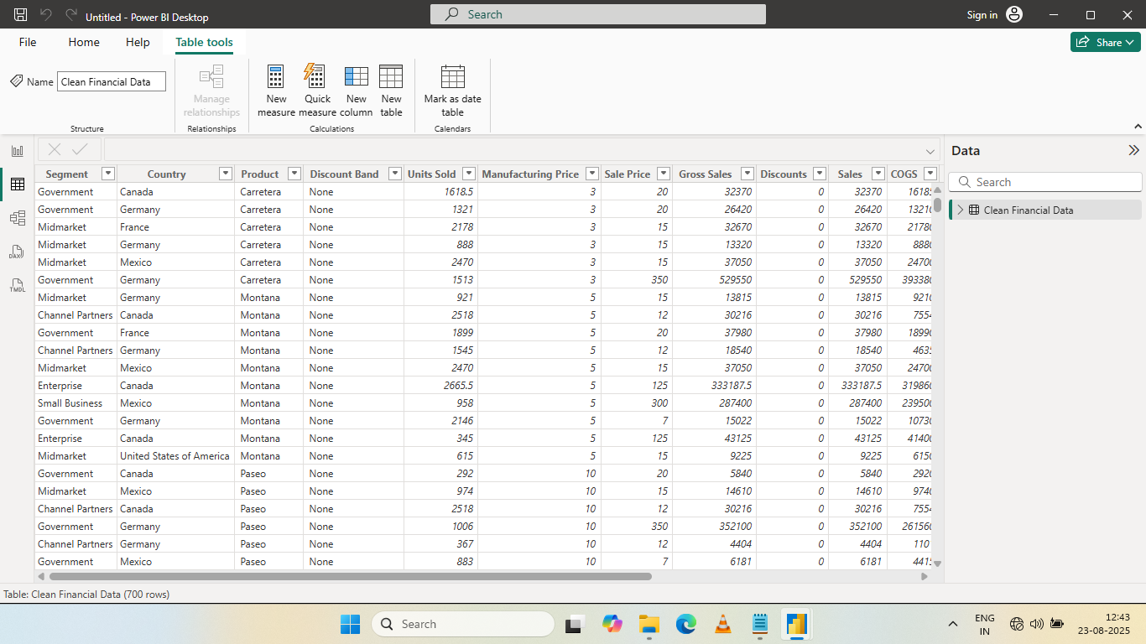
Create measures use them in the data visualization and make an interactive Dashboard.

Slide 27
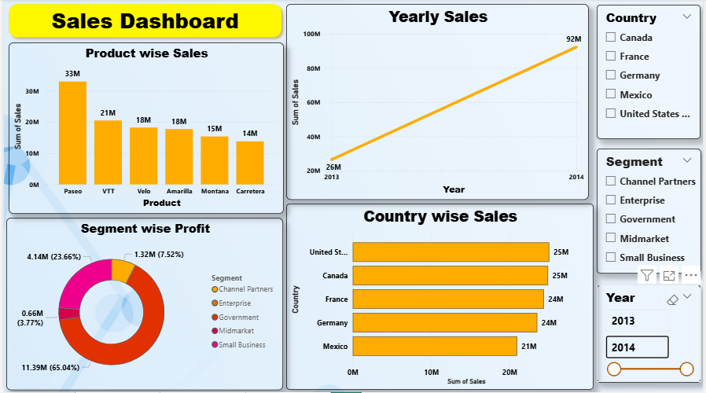
Dashboard - 1

Slide 28
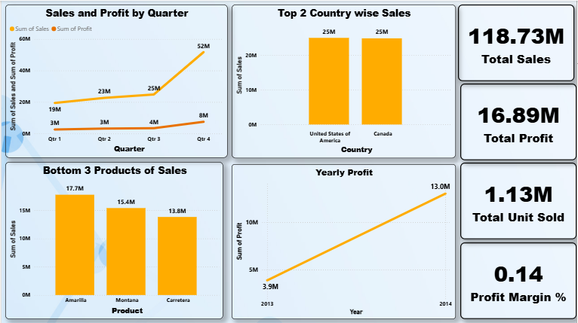
Dashboard - 2

Slide 29
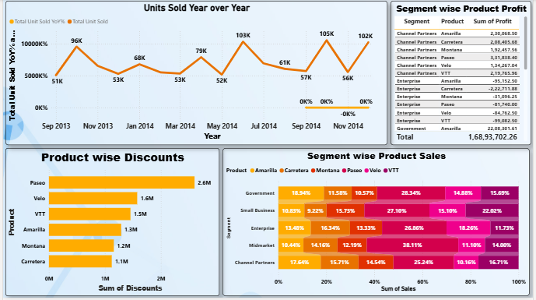
Dashboard - 3

Slide 30
Derive Conclusion and from the Dashboard
Overall Performance:
Total Sales (118.73M)
Total Unit Sold (1.13M)
Total Profit (16.89M)
Profit Margin % (14%) Which is moderate and indicates scope for better cost optimization.
Product Performance:
Top Selling Product - Paseo ($33M)
Lowest selling Product - Carretera ($14M)
Profit by Bottom:
Carretera (1.8M)
Montana (2.1M)
Velo (2.3M)
Discount by Products:
Paseo (2.6M)
Velo (1.6M)
VTT (1.5M)

Slide 31
Derive Conclusion and from the Dashboard
Yearly Quarterly Performance:
Sales Growth Sales jumped from 26M in 2013 to 92M in 2014, indicating a 254% growth.
Profit Growth Profit increased from 3.9M in 2013 to 13M in 2014, showing a positive upward trend.
Qtr4 is Best quarter with $52M sales and $8M profit (Peak).
Qtr1 is a Weakest quarter with $19M sales and $3M Profit.
Recommendation: Leverage Q4 trends for future promotions and stock planning.
Insight: The business scaled effectively year-over-year.
Country-wise Insights:
United States and Canada lead with 25M each in sales.
France and Germany are close at 24M each, while Mexico lags at 21M.
Opportunity: Focus on strategies to increase Mexico’s sales.
Top 2 Selling Countries: United States of America & Canada.
Product-wise Insights:
Best-selling Product Paseo (33M) followed by VTT (21M).
Least-selling Products Carretera (14M), Montana (15M), and Amarilla (18M).
Discount Analysis: Paseo receives the highest discounts (2.6M), which may indicate aggressive promotional campaigns.

Slide 32
Derive Conclusion and from the Dashboard
Segment-wise Insights:
Highest Profit Segment Government (11.39M; 65.04%).
Lowest Profit Segment Midmarket(0.66M; 3.77%).
loss in Enterprise (-0.6M)
Insight: Government segment is highest Profitable segment and Enterprise Segment is loss making Segment.
Key Recommendations:
Focus on Profit Margins: Explore cost reduction or price optimization for low-margin products and segments.
Boost Under performing Regions: Create targeted strategies for Mexico to match other countries’ performance.
Optimize Discounts: Review high discount levels, especially for Paseo, to see if they are necessary or could be optimized.
Leverage Q4 Trends: Allocate more inventory and marketing budget to capitalize on Q4 demand surge.
Deep-dive into Enterprise Segment: Investigate why enterprise sales yield low or negative profits for certain products.

Slide 33


